Slide 1
ISSUE 6 | 29 June 2023
30 June
Last day of term
18 July
All students to return to school
23 August Year 11
B Street Smart Excursion
19 Sept
Year 12 Excursion
21 Sept
Year 12 Graduation ceremony
Term 2 has been another very busy and successful term. It was wonderful to see so many parents in attendance at last week’s Assembly of Excellence.
I was equally thrilled to see such a large number of students being acknowledged for their ongoing effort. Success at school is a team effort and student learning outcomes are maximised when students, staff and parents work closely together.
I have a deep passion for learning and believe every student, regardless of circumstance, deserves a quality education to support them to be successful lifelong learners and productive members of society.

Slide 2
During Week 8, I attended the NSW Secondary Principal Council’s Annual Conference in Tamworth and engaged in numerous professional learning sessions to build my own leadership capacity to allow me to be the best Principal I can be for the students and families of Erina High School.
At the conference the Minister for Education, Prue Car and the newly appointed Secretary of Education, Murat Dizdar gave presentations to Principals. Both Prue and Murat spoke passionately and clearly about their desire to improve schools and support teachers and teaching at a much higher level than in the past. There is a great deal of optimism and confidence in schools right now, I see teachers excited about the future.
To conclude, I would like to acknowledge the staff at Erina High School who are working very hard to support your children and make their educational journey both challenging and enjoyable.
I hope everyone has a safe, restful and enjoyable school holidays and look forward to seeing all students return to school on Tuesday 18th July.
Paul Broadbent
Principal
Parent Reminders
Students are encouraged to attend Sick Bay if they feel unwell so Administration staff are able to communicate with parents and carers, and provide the best care possible.
Administration staff will contact parents and carers if needed to collect their child, to minimise class distractions and have them ready for collection.
If you have a Year 6 student enrolling at Erina High School for 2024, if you have not already done so please complete your online enrolment as soon as possible.
Statements have been emailed out this week, Sport for Term 3 will need to be paid for asap to be able to participate.

Slide 3
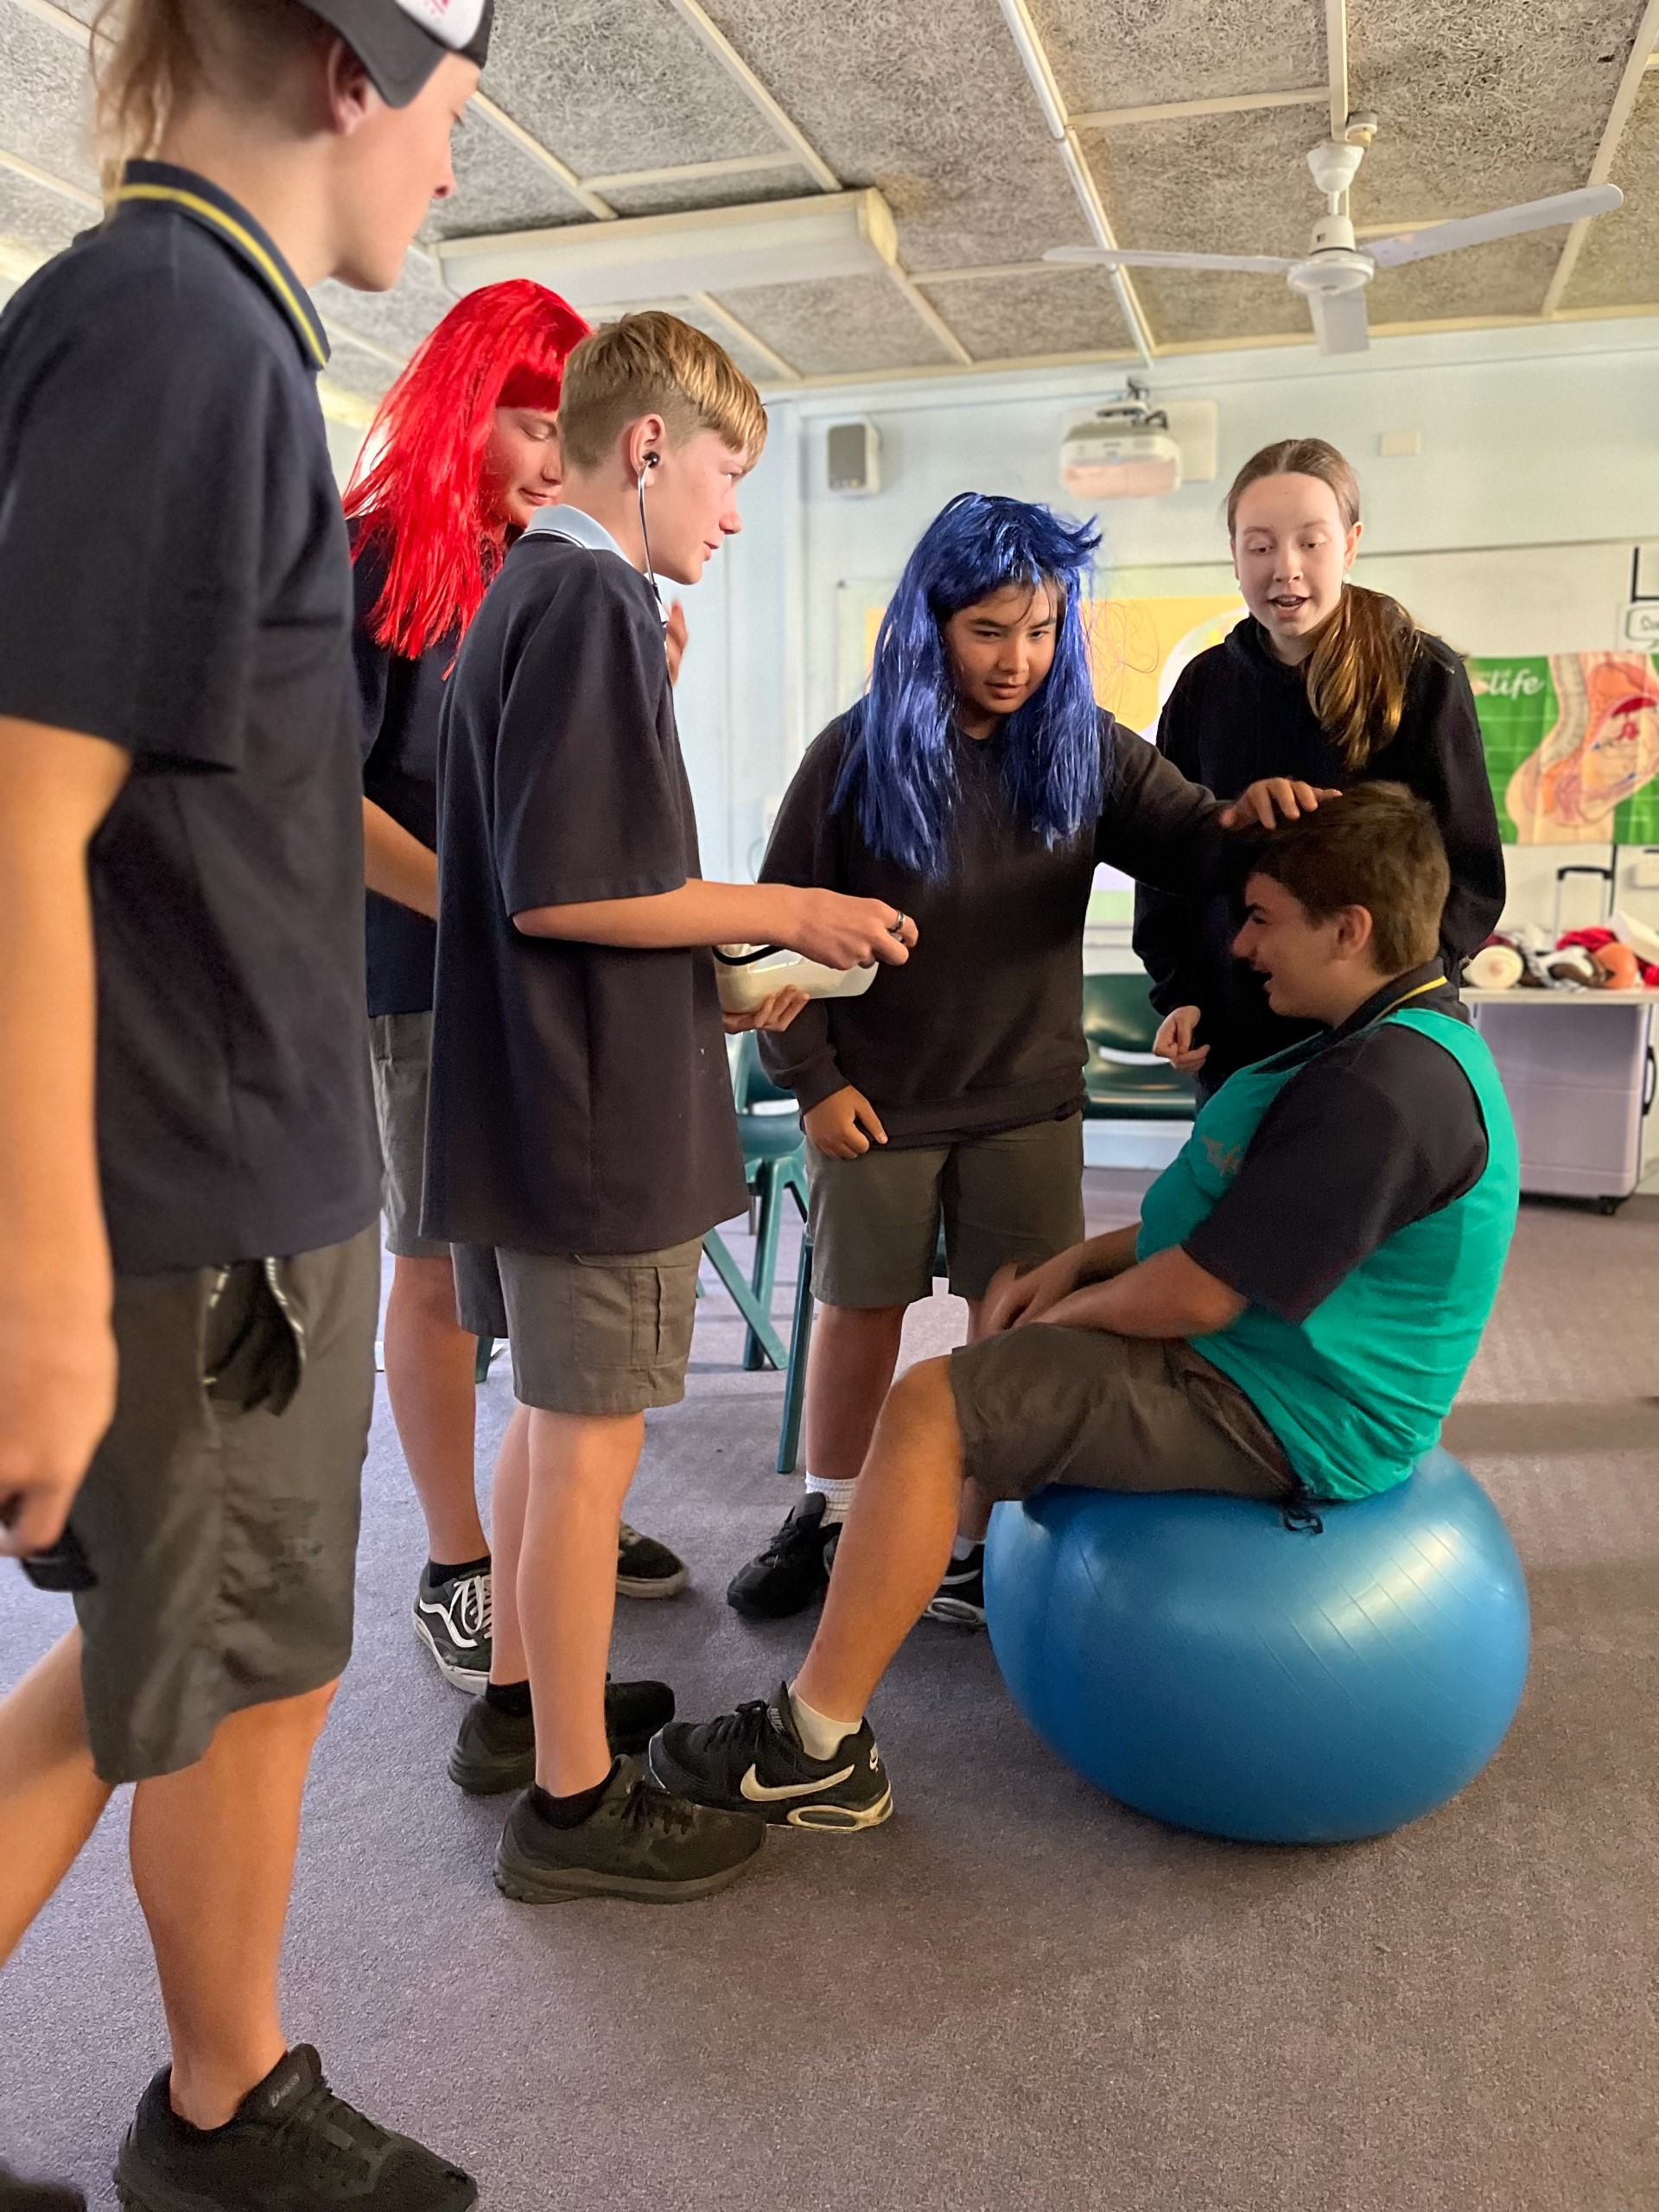
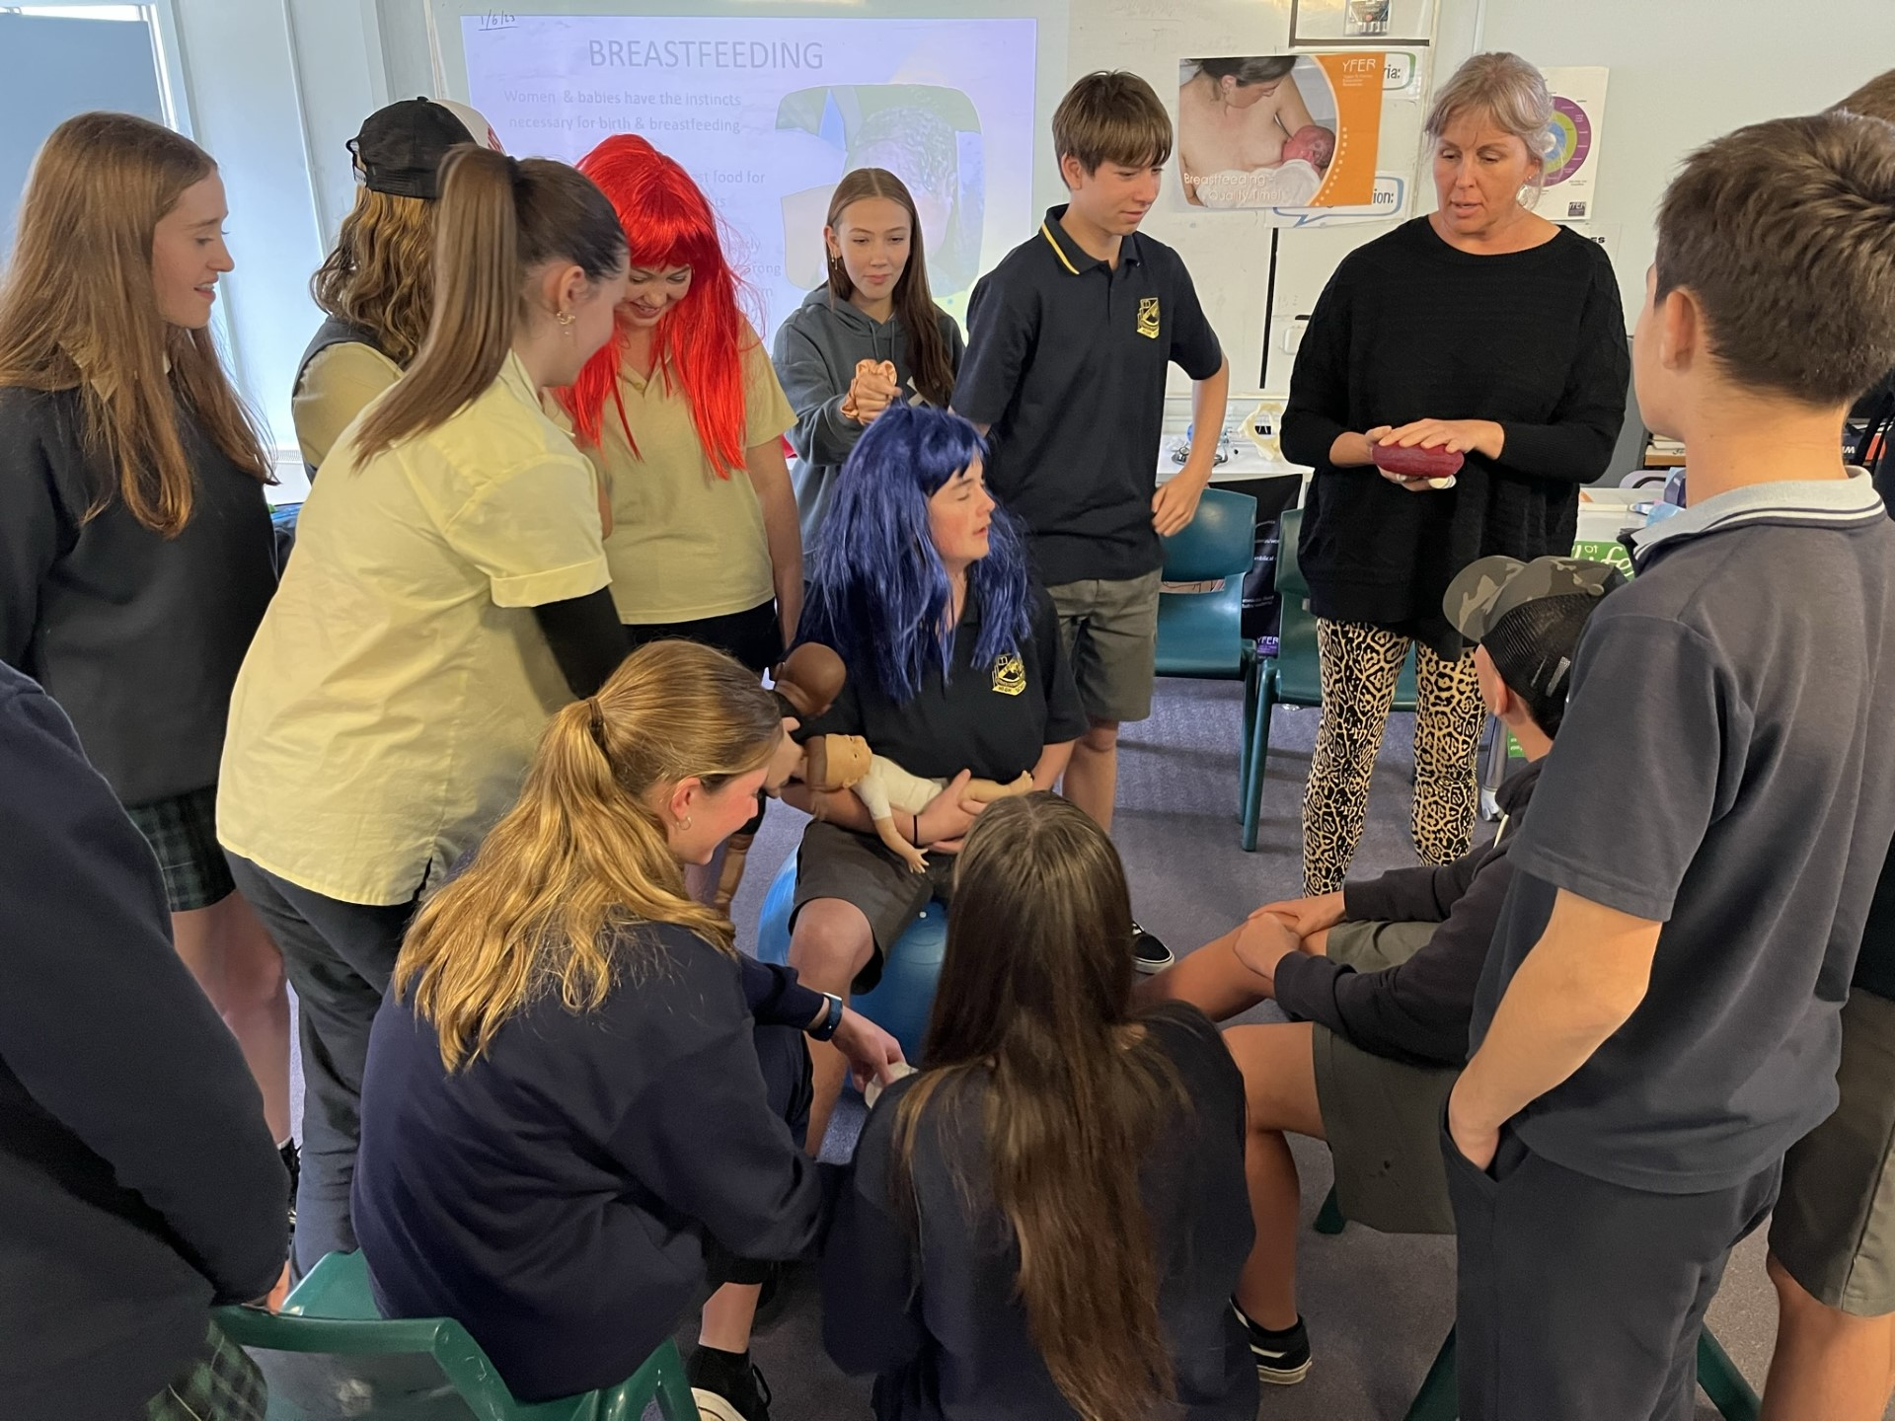
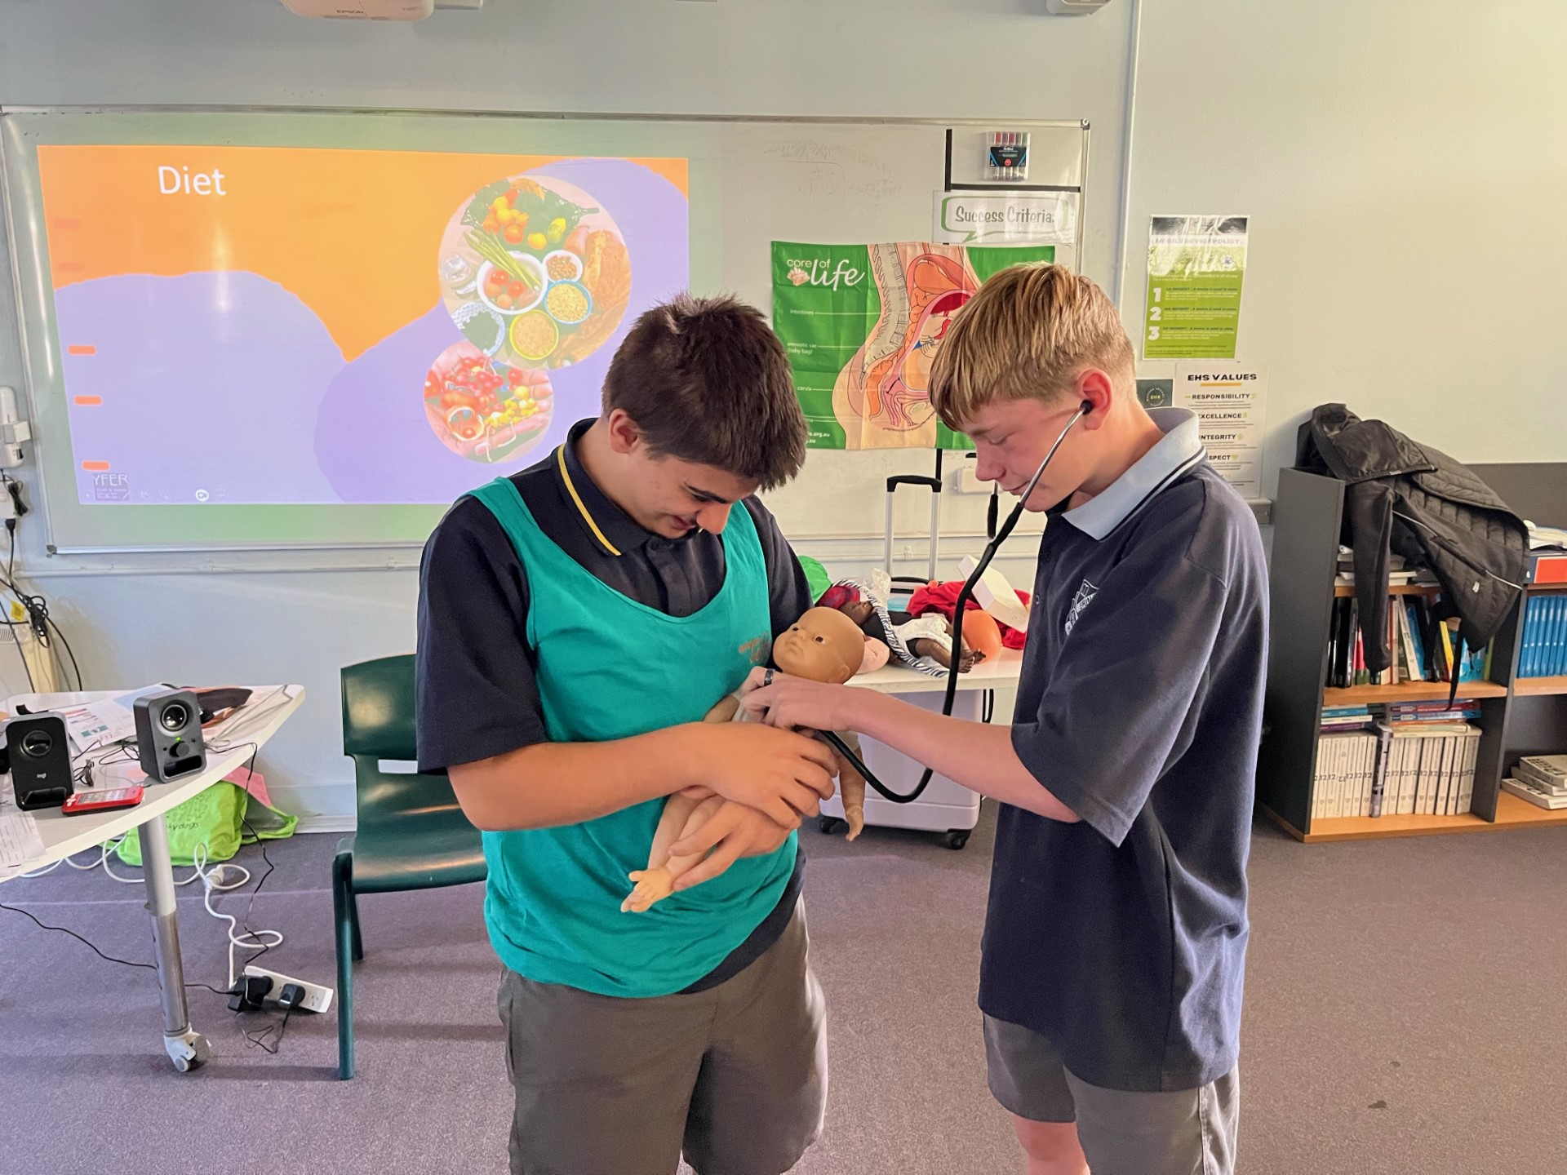
Year 9 News
Year 9 students participated in the Core of Life program in Week 6. The program has been specifically developed as a health promotion/early intervention, relationships & reproductive health education program. It aims to directly empower young people to build resilience for healthier, more timely parenting futures. All our students enjoyed the interactive nature of this program and were particularly engaged in the role play activities. As a result of the program, our students feel stronger about making healthier choices and have developed their capacity and skills as future parents.
A huge thanks to Core of Life and all of the facilitators who gave up their time to inspire and educate our students.

Slide 4
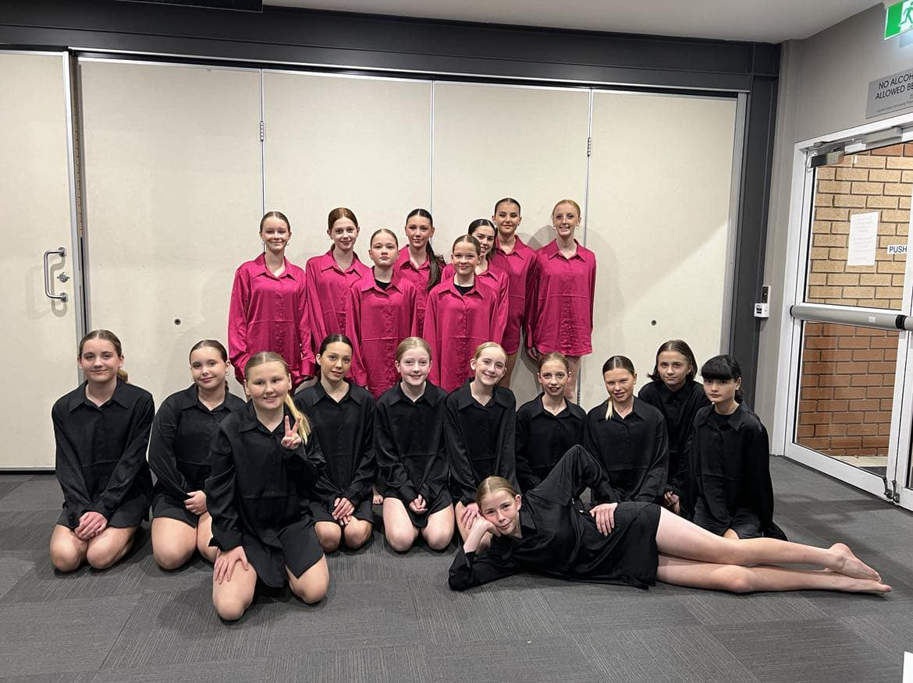
Central Coast Dance Festival
Congratulations to our Junior Dance group for their beautiful performance of their item 'Ending' at Central Coast Dance Festival last night. The girls have all worked very hard attending many rehearsals to learn and perfect their choreography. They were excellent representatives of Erina High School and we are very proud of their efforts.
Special thankyou also to Maddie T of Year 10 for all of her time and effort in choreographing a fantastic item for our junior students.

Slide 5
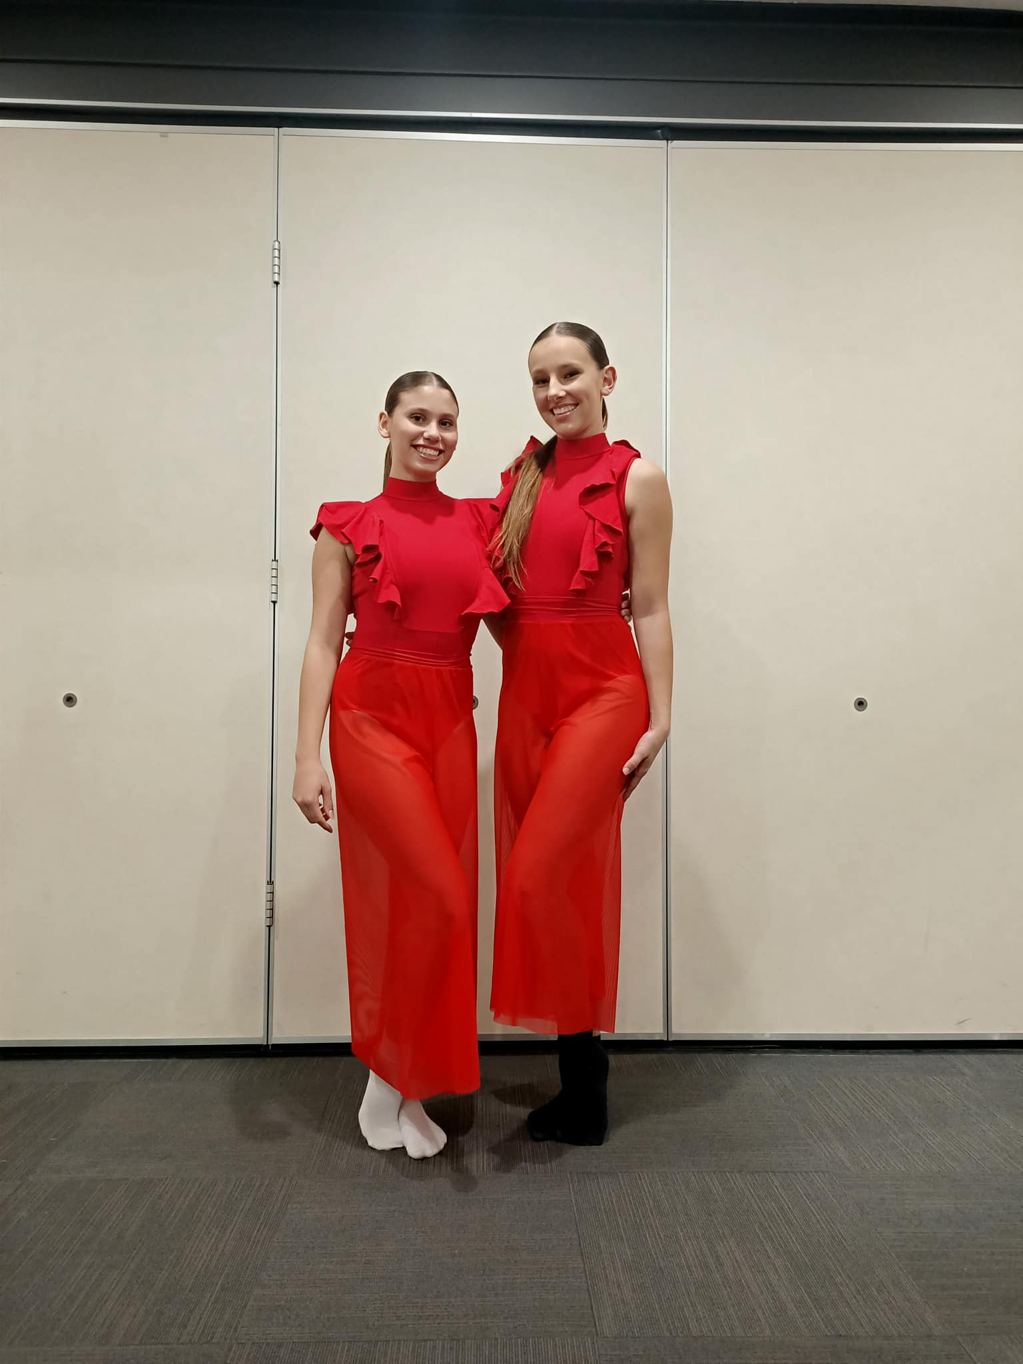
Central Coast Dance Festival
Congratulations to Maddie T and Addison B of Year 10 on their beautiful performance of their item 'Letter' at the Central Coast Dance Festival. The girls were selected from dancers across Central Coast High Schools to perform in the Senior Dance Ensemble. Erina High School is very proud of your achievement.

Slide 6
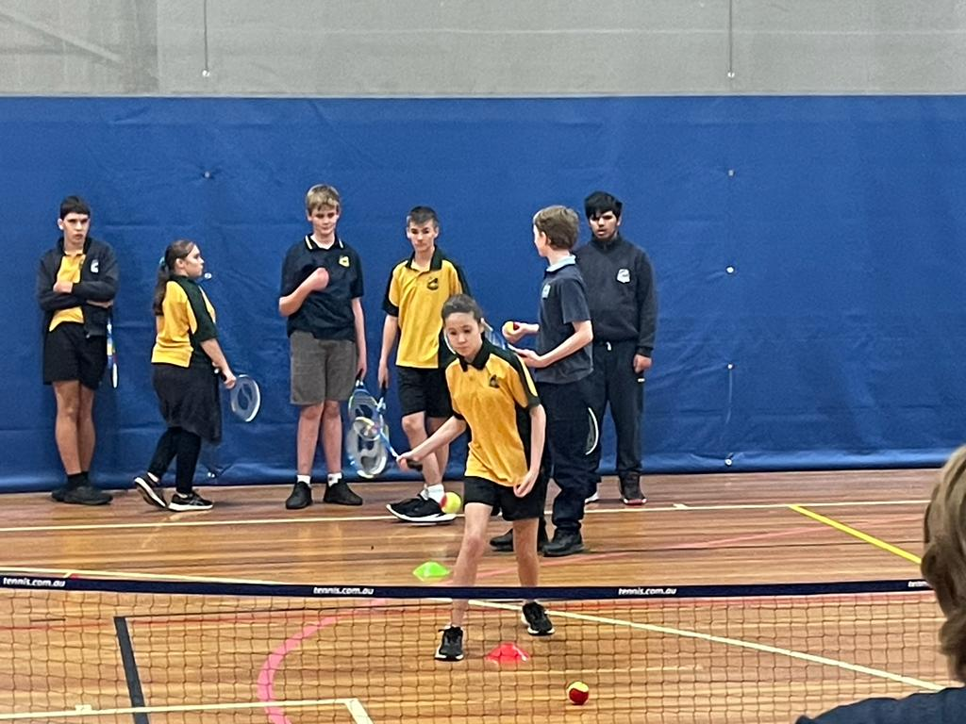
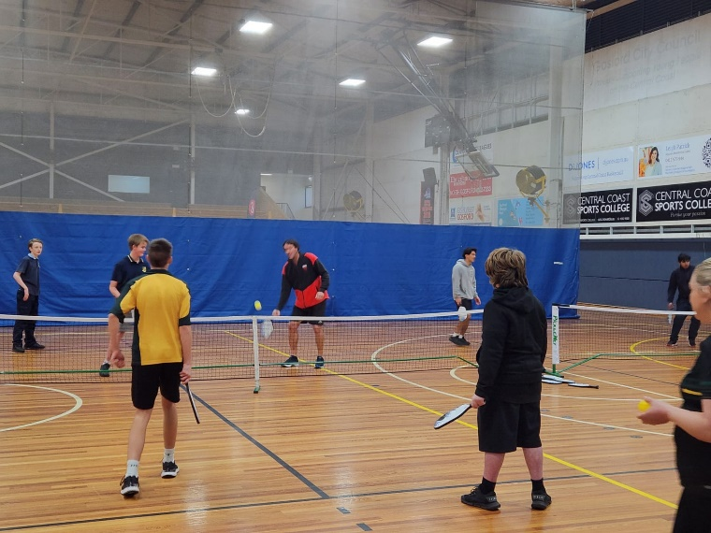
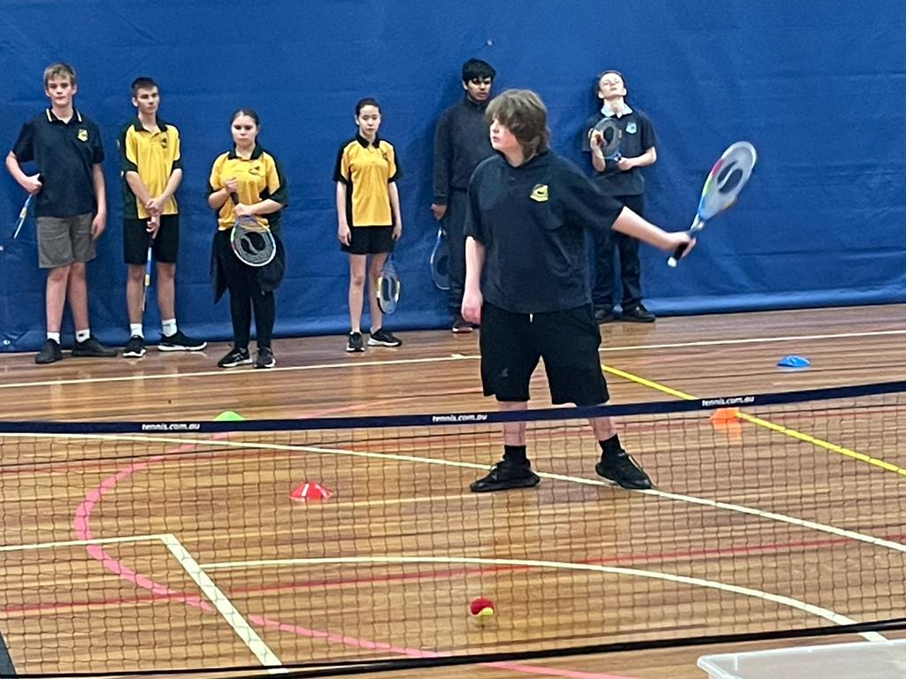
Mirrabooka News
Multi-Sport Day
On Thursday June 15 Mirrabooka students participated in the Multi-Sport Day event at Niagara Park Stadium. Erina High School was represented with pride and the students demonstrated high levels of engagement and participation throughout the day. Along with many other Central Coast schools, Mirrabooka tried their hands at many sports including golf, pickle-ball, boccia, cricket and soccer and did so with enthusiasm. Thank you too all the staff and students for their efforts on the day.

Slide 7
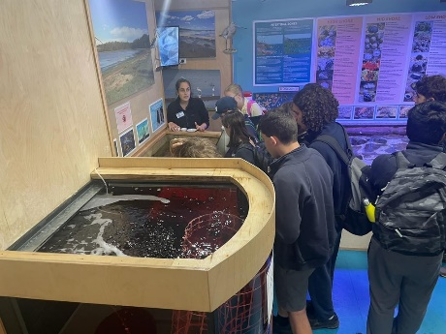
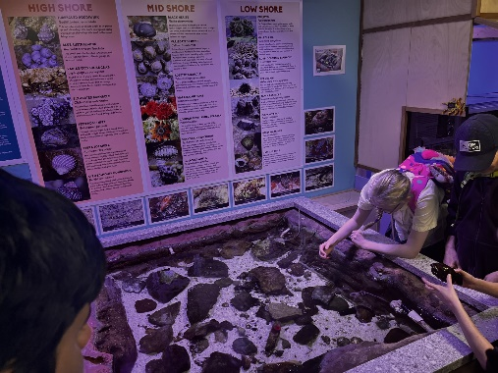
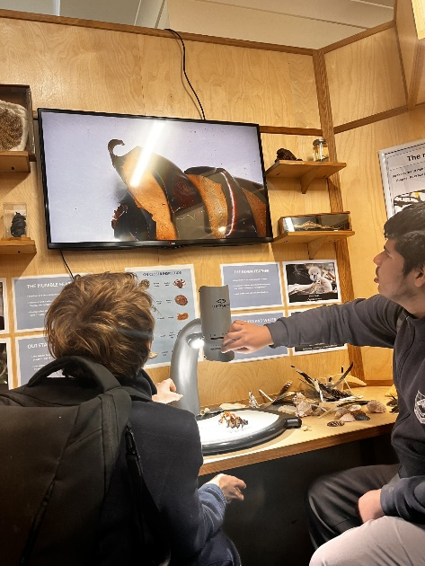
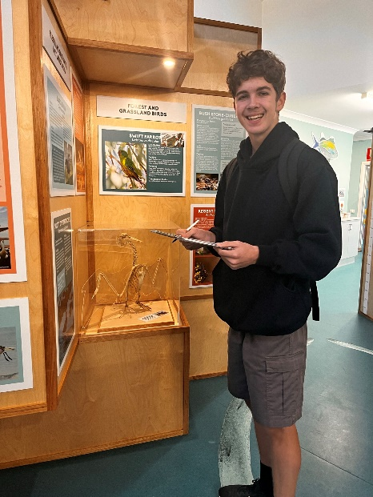
Mirrabooka News
Community Access
Students from Mirrabooka visited the Rumbalara EEC and Central Coast Marine Discovery Centre in Terrigal for their Community Access Program. At Rumbalara, students participated in a bush walk investigating our local ecosystems, scratch art and using microscopes to explore different species. At the Marine Centre, students participated in a guided tour and watched a feeding of different marine life in the centre. Thank you to all the lovely staff at both venues!

Slide 8
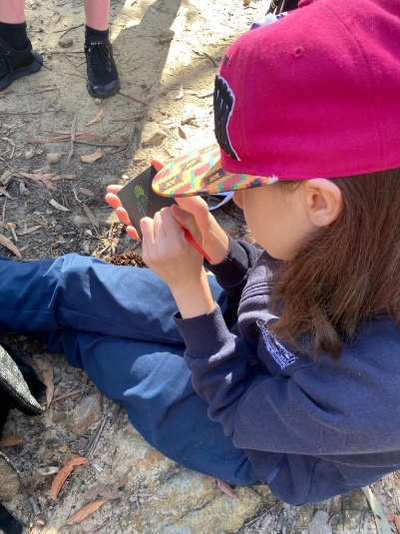
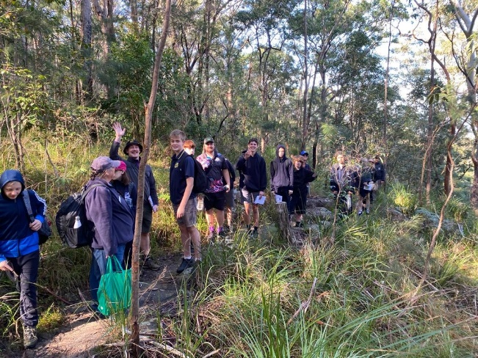
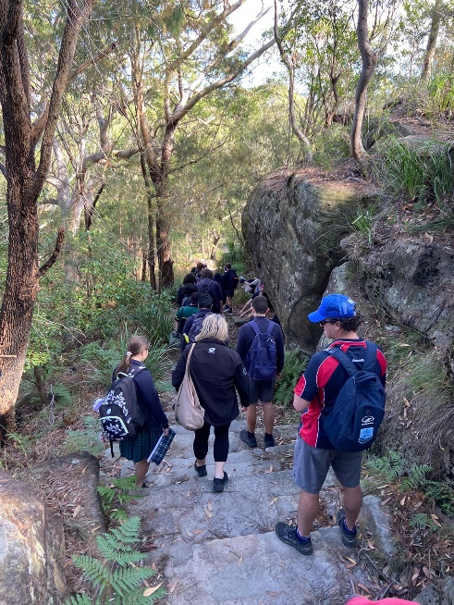
Mirrabooka News

Slide 9
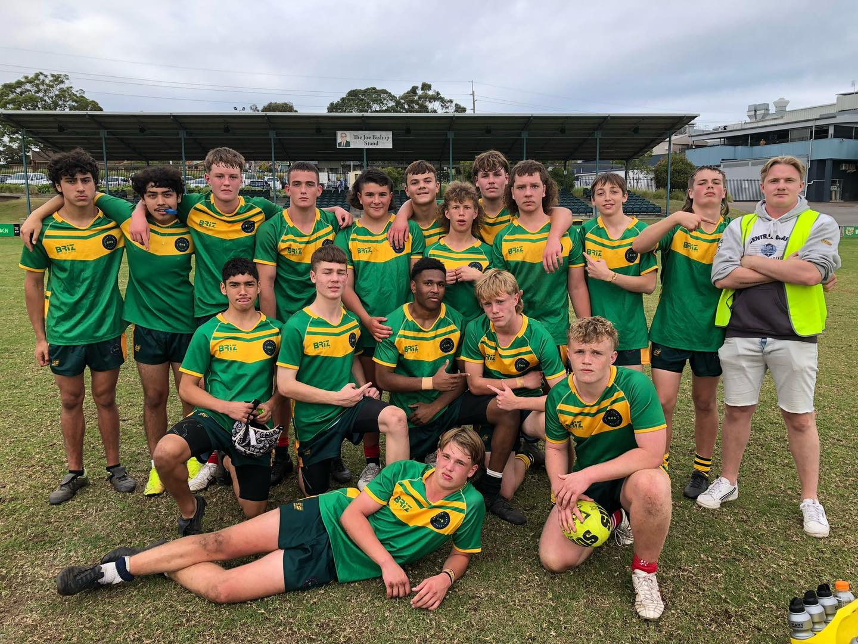
Sport News
The Erina HS 16 Boys Rugby League side recently competed in the NRL Central Coast Gala Day at Wyong.
The boys put some strong football together to first comfortably defeat MacKillop Catholic College and backed up the performance with another solid display that saw Erina defeat St Edwards College by a tight margin.
The two victories saw Erina HS move through the group stage undefeated but a massive task awaited as we were then drawn to play Central Coast Sports College in the semi final.
Erina were on the back foot early on as the rep-stacked roster of the Sport College produced some very slick play to get through on Erina's fringes. However, Erina didn't back down, consistently defending with resilience in the middle of the field and adapting to CCSC's attack. In the second-half of the match each side scored one try.
Erina HS should be very proud of the way in which all players represented the school, displaying sportsmanship and determination.
Several of the boys will maintain their place in the side for next year, as they are currently only 15, and many of the 16s backed up a week later in the Open's competition. Thank you also to Ayden Stokes for assisting as 'Trainer' on the day.

Slide 10
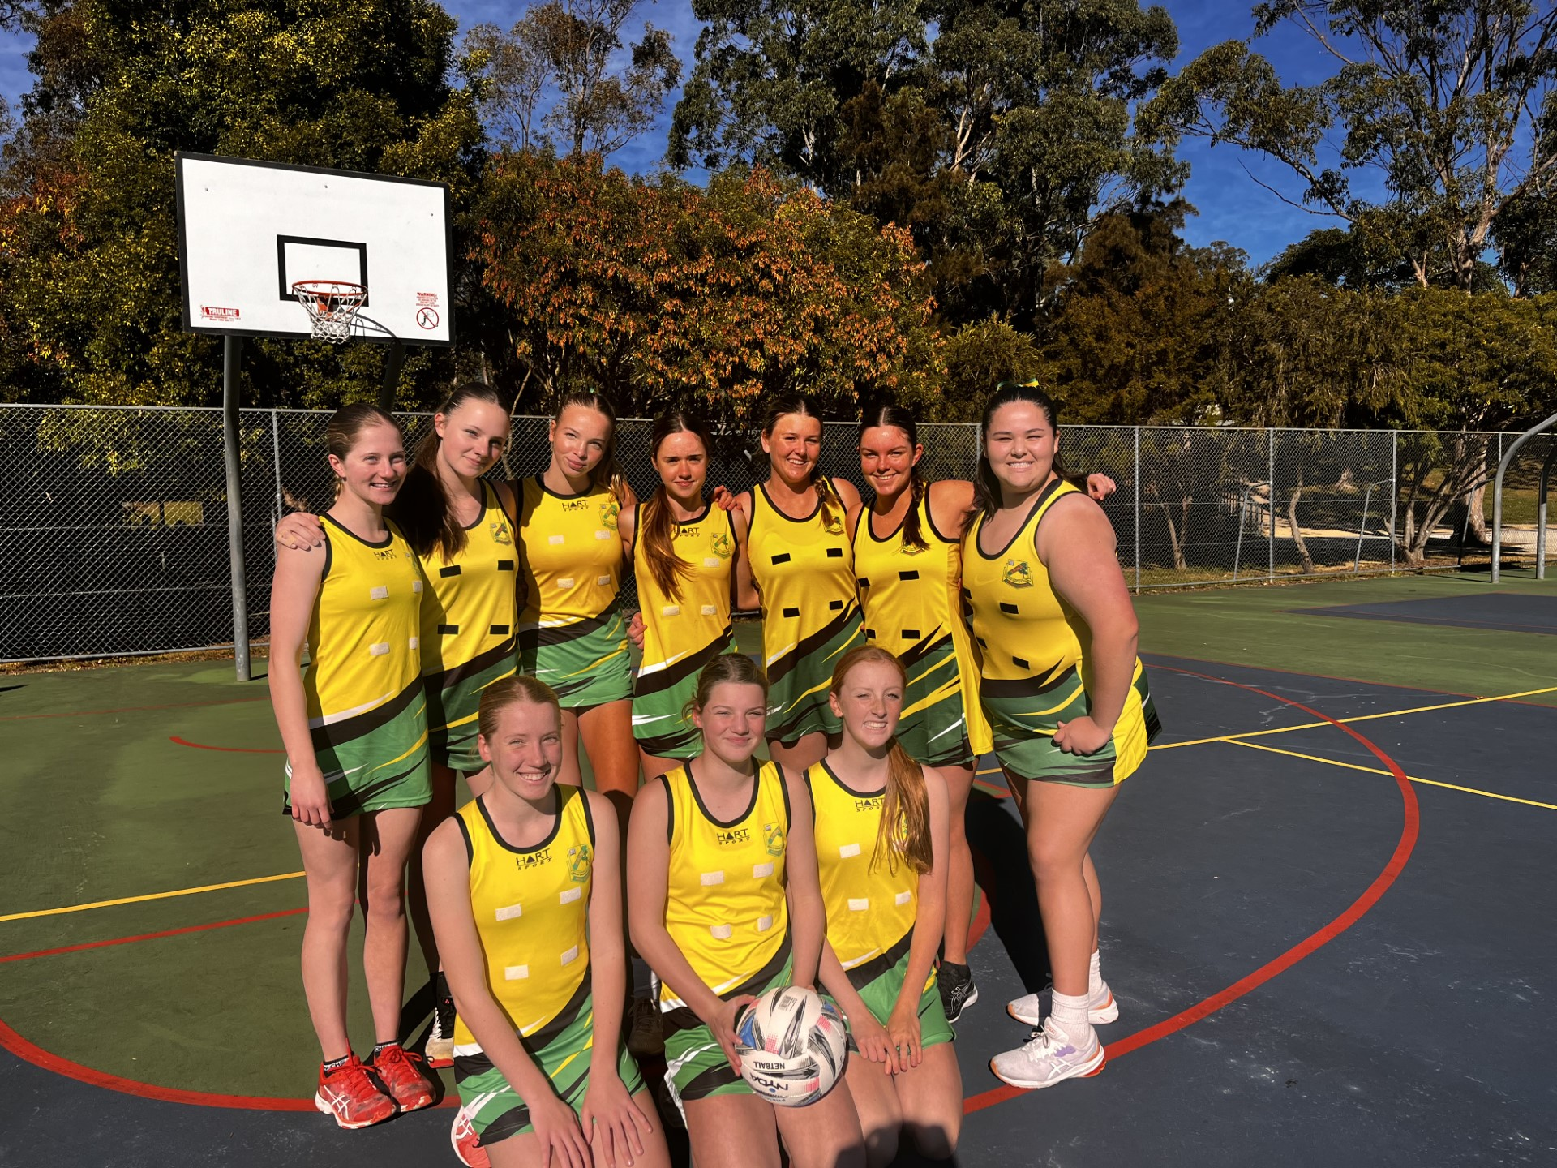
Sport News
On Monday 19th June, the EHS U15's Netball Team versed Carlingford High School in Round 2 of the CHS Knockout. The girls played with grit, passion and determination in a close competition and came through for the win with the final score being 34-28.
High praise should be given to all of the girls, particularly for their positive attitude and teamwork! Special mentions go to Ciarn S for Player's Player, Gemma A for Best and Fairest and Charlee F for Coaches Encouragement (whose shooting prowess was unmatched!) Well done girls on such a great game!

Slide 11
Leadership Programs

